Slide 1

DragOnFlow
Deliver content and transactions by simply drawing a flowchart
sarid@cellesense.com
+972 3 604 3350
+ 972 544 368 961

Slide 2
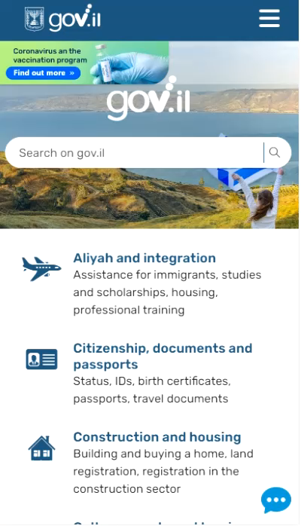
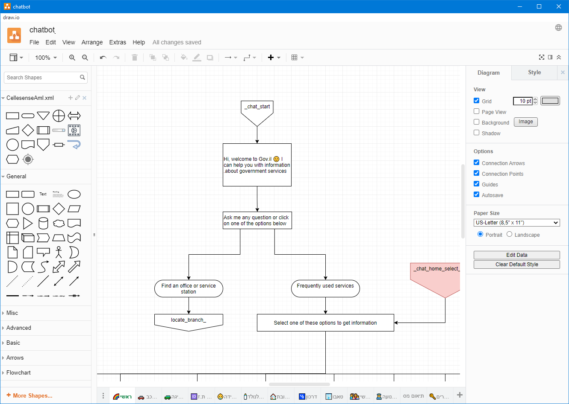
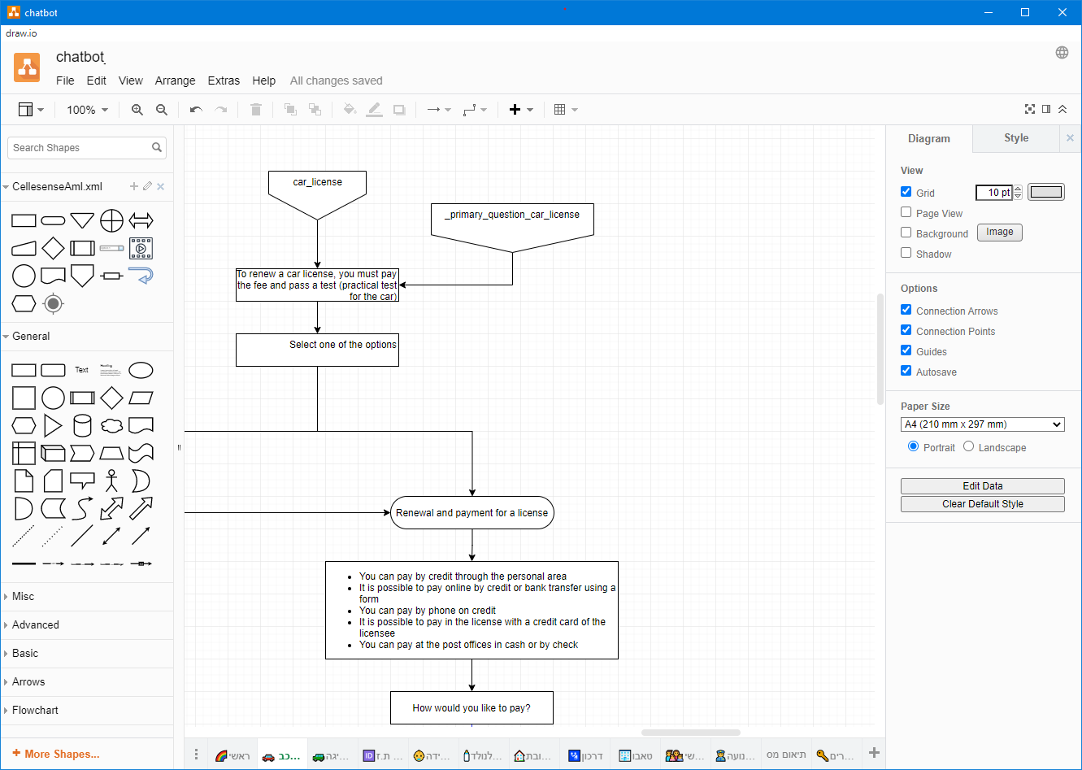
Create an app directly from your flowchart
Automatically convert a flowchart into a multi channel App.
Easy and intuitive use:
  draw a flowchart using known tools
  upload the drawing into the server
  your App. is ready to be used

Slide 3
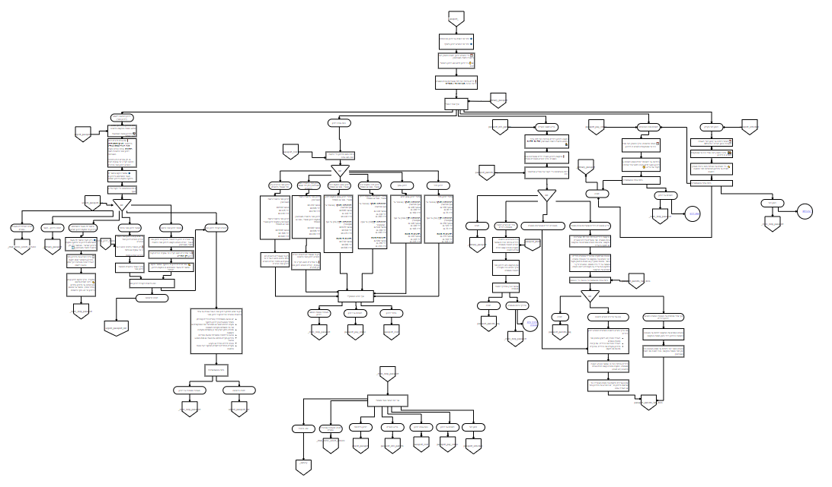
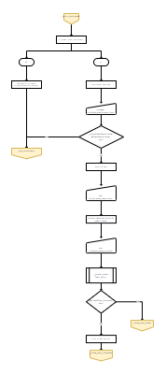
Simple or Complex – Drag-On Flow can do it
A single app can include dozens of charts

Slide 4
How does it work?
Install the server on premise / private cloud or connect to a cloud
Optionally integrate Backoffice API
Choose a drawing tool (Visio, Draw.IO…)
Draw your flowchart (including your content)
Upload it to the server and you are done!

Slide 5
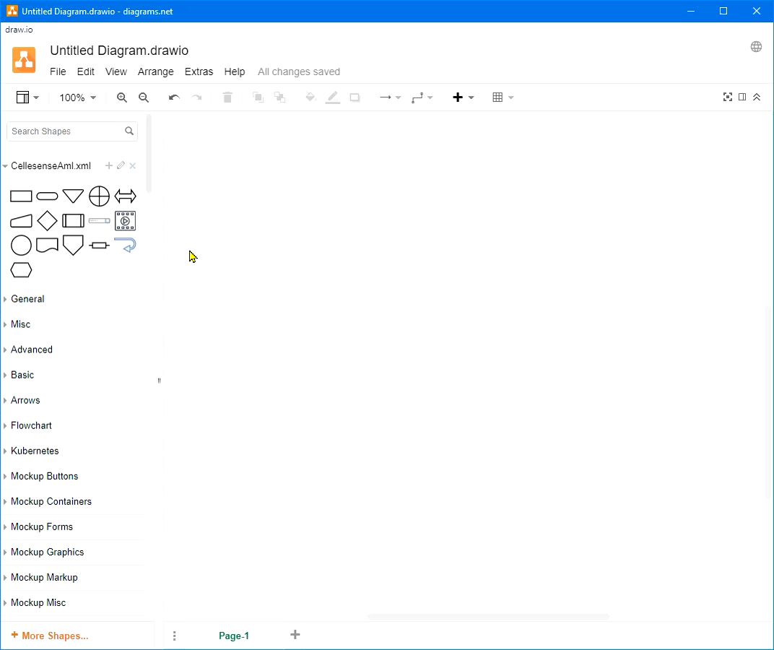

How do you build an application?
Each shape defines a function:
  Starting point
  Text
  Navigation buttons
More capabilities:
  request info and data from users
  presenting multimedia files
  search
  terms of use
  execution of services in other systems

Slide 6
Advantages
Use off-the-shelf familiar software (e.g. Visio, DrawIO, power point)
  Anyone can draw a flowchart and work on it; off line, anytime, anywhere
  No need for development environment
Full customization of UI & Logic flow
Multi channel & Multilingual
Real time validation of data using back-office data
Low Code

Slide 7
Advantages (2)
Integration with search engine
Integrate code & assemblies within Drag On Flow
    No need to change existing systems
Auto-complete - based on semantic data
AI for F.A.Q.
Safe – installs on premise, does not use external/cloud services
  Each application runs in a separate process

Slide 8
Use cases
Bots - Multi channel (Web, IM, Mobile app)
Presentation layer for back-office transactions
  E.g. login, execute queries, execute transactions, schedule tasks…
Fill-in / create on line documents (forms)
Operation manuals and troubleshooting
CRM activities – open/close/manage processes …

Slide 9


The offering
Launch multi- channel business applications with no dependency on external platform
Use standard off-the-shelf tools (PPT. Visio) to create a flowchart which is automatically converted into a biz app
Maintain & control your App information, updates and editing, independently
Integration with major Instant Messaging networks

Slide 10
IT offering
Web dashboard.
Reports & analysis
Integration with live agents when needed
Installation on premise or cloud
Includes search, word completion, geo-coding, multimedia…

Slide 11







Some of our customers

Slide 12
Thank you,
Your Cellesense Team
Powerful Apps – Super Easy
sarid@cellesense.com
+972 3 604 3350
+ 972 544 368 961

