Slide 1
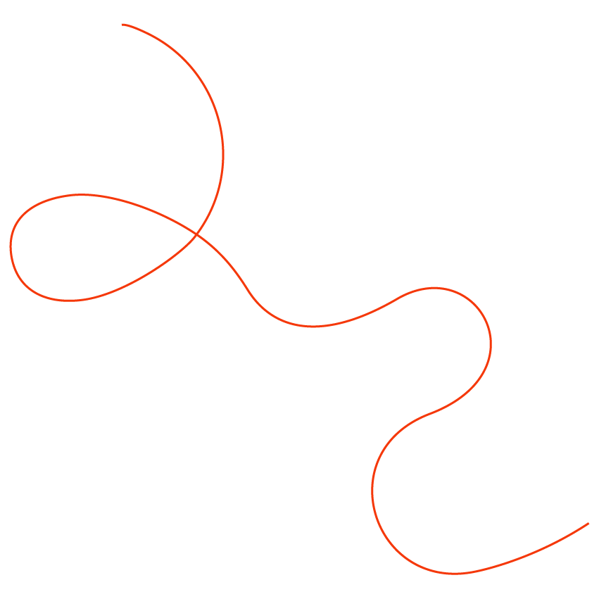

Nice to meet you
Company profile

Slide 2
We are
Naot

Slide 3
For 80 years, we have been
handcrafting shoes together.

Slide 4

Main Target Audience
01
Xennials (35+ the group between Generation X and millennials)
Stylish 50+ women
02
Our customers are women who have reached a point in their lives where they are more confident in themselves.

Slide 5
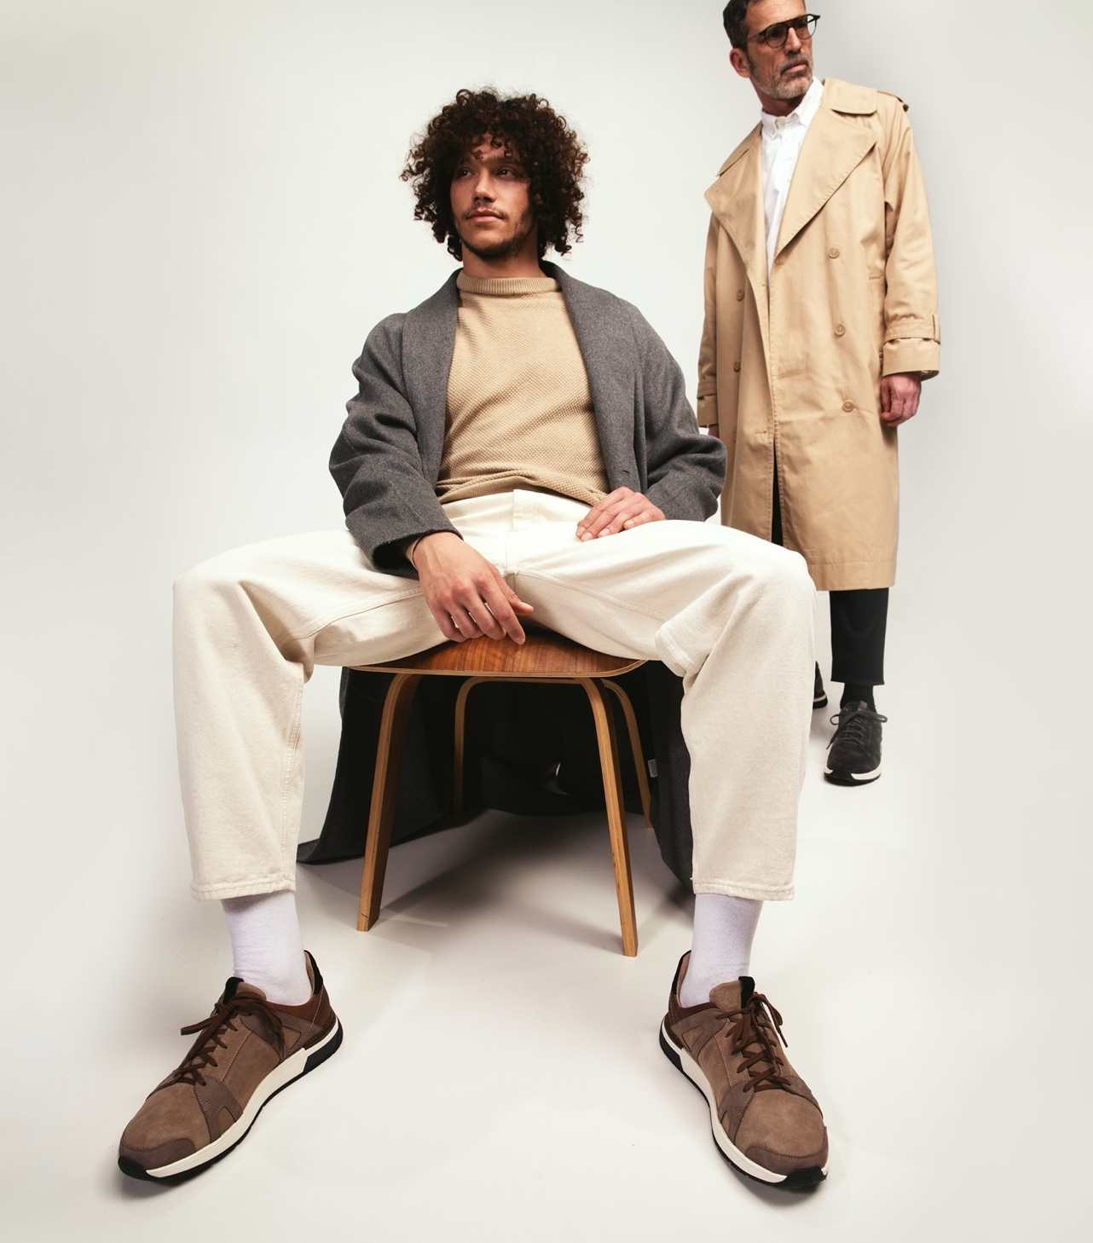
Secondary target audience: men
The brand speaks to all genders! We also appeal to men and we have a lot to offer them!

Slide 6
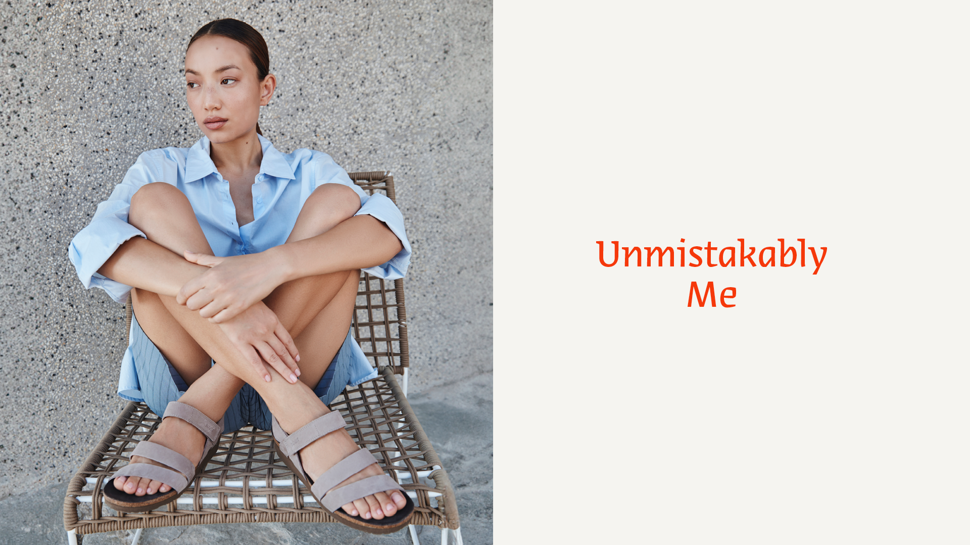

Slide 7
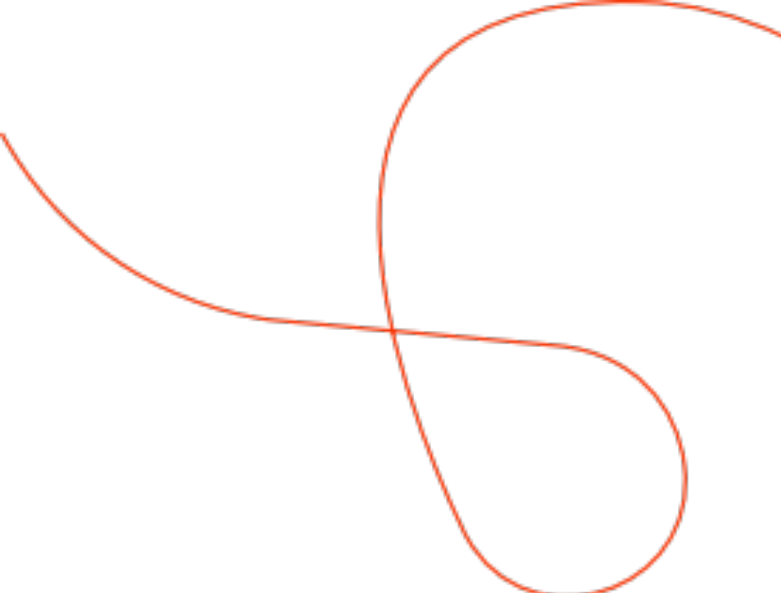
COMPANY

Slide 8

Naot Milestones
2003 | 2000 | 1996 | 1991 | 1986 | 1946 | 1942
Chain stores in Israel | 70% export | Removable insole Development | Naot start to export internationally | Cork Concept developed | Arrive to Neot Mordechai in the North of Israel | Pioneers in Kibbutz Evron

Slide 9
Naot Milestones
2021 | 2020 | 2018 | 2017 | 2015 | 2009 | 2006
5 years strategy | COVID adjustment and full operational sequence | Naot Distribution Japan & Singapore | Naot Acquisition of the Australian Distribution | Naot Acquisition of the Canadian Distribution | Naot Acquisition of Dafna | Naot Acquisition to private owned
2024
Re-branding

Slide 10
Our Vision
Naot believes that encouraging individual expression makes the world a more interesting and better place.

Slide 11
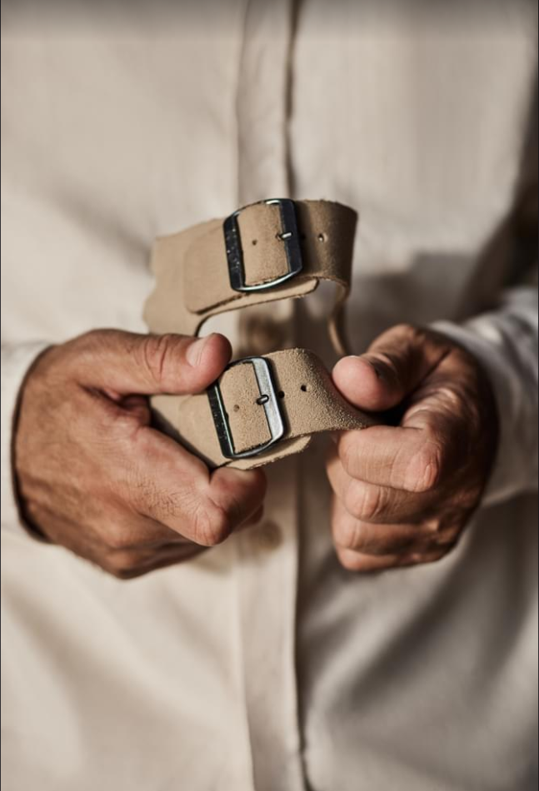
Our Mission
To handcraft the most comfortable, beautifully designed shoes that let people express their true selves and walk with self-confidence.

Slide 12
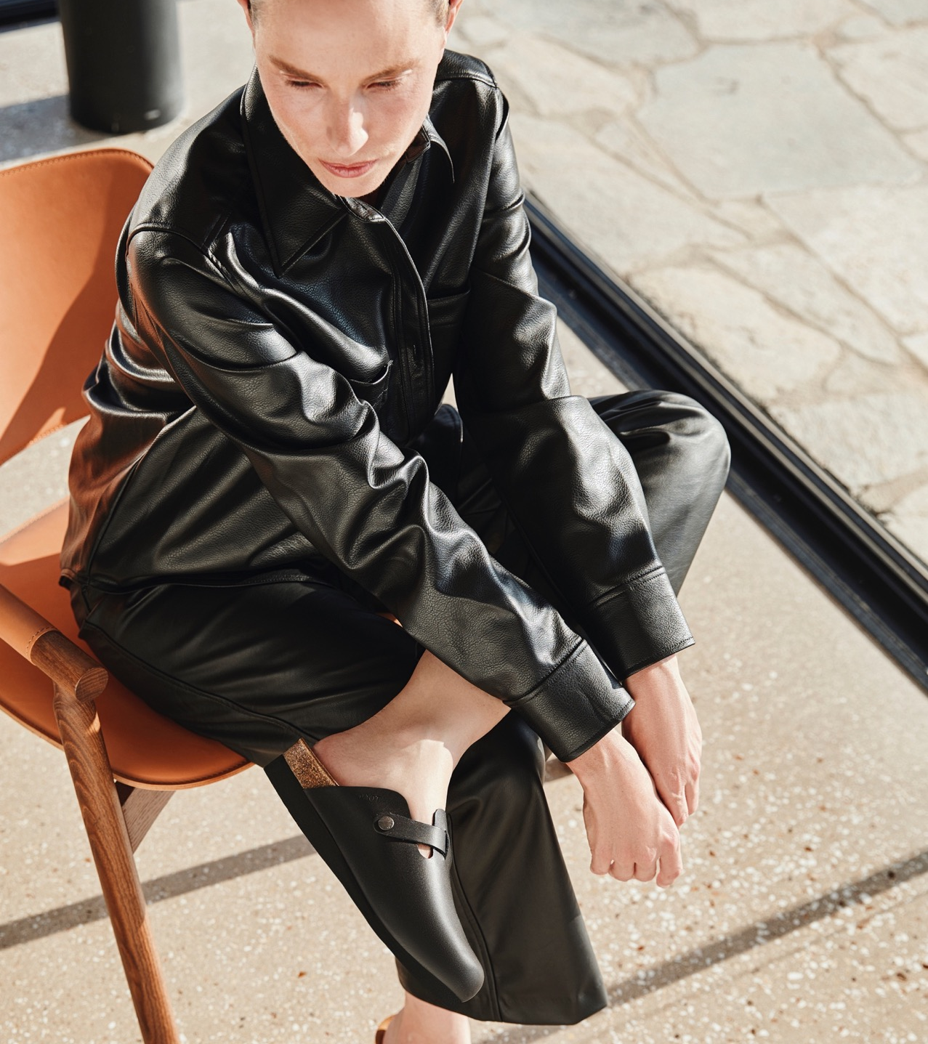

Number of employees Naot :
400 (70% women)
NAOT employees are a diverse community – Arabs, Druze, Christians, and Jews working together in the Galil in northern Israel.

Slide 13


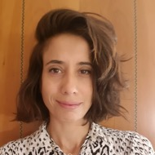

Naot’s Designer Team
This diverse group ensures that Naot's designs
are always fresh and relevant without ever compromising on the comfort that the brand is known for.
Their shared passion for making people "walk wonderful" shines through in every pair of shoes they create, combining stylish flair with the utmost in comfort. With Naot, you can be confident that you're stepping into shoes that look great and feel even better.
Naot's footwear design team
is a wonderful blend of four talented women, each with her own unique style and perspective. Ranging in ages and backgrounds, they bring a richness of experience and creativity to the brand.
Nitsan
Rotem
Karin
Hagit

Slide 14
PRODUCT
Unmistakable care taken into the design, comfort and quality of each shoe

Slide 15

Manufacturing all shoes in Israel, the home of Naot, where we oversee and influence every stage of production.
Meticulous attention to the design, comfort and quality of each shoe by:

Slide 16

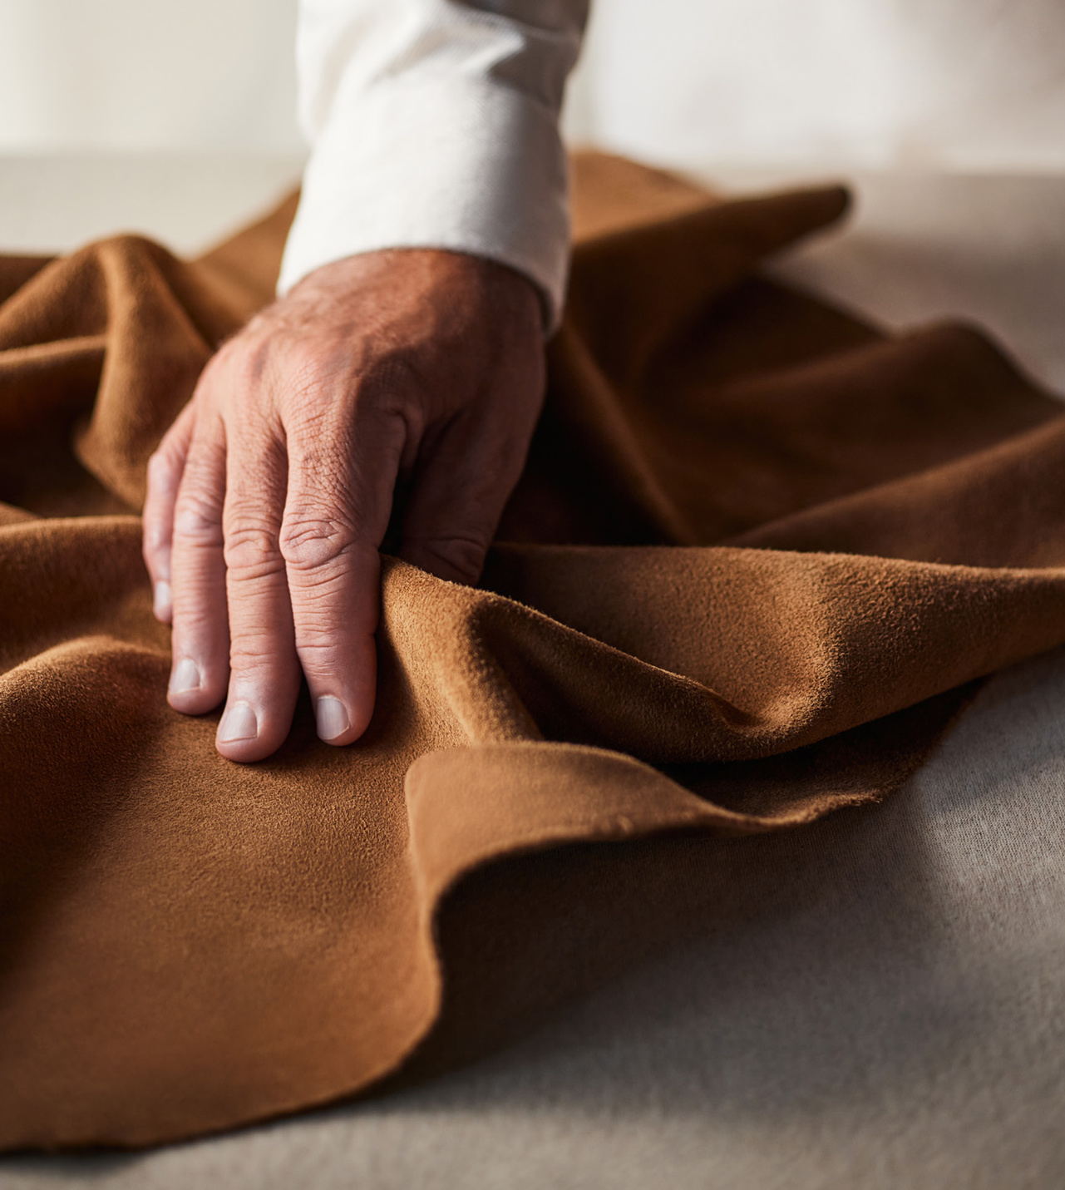
Maintaining the human touch in production
including hand-sewn elements and our ‘quality testing’ program which ensures optimal comfort and durability. Every shoe is handled by at least 50 people.

Slide 17

Using the highest
quality materials
including the finest Italian leathers and natural cork from Portugal.

Slide 18
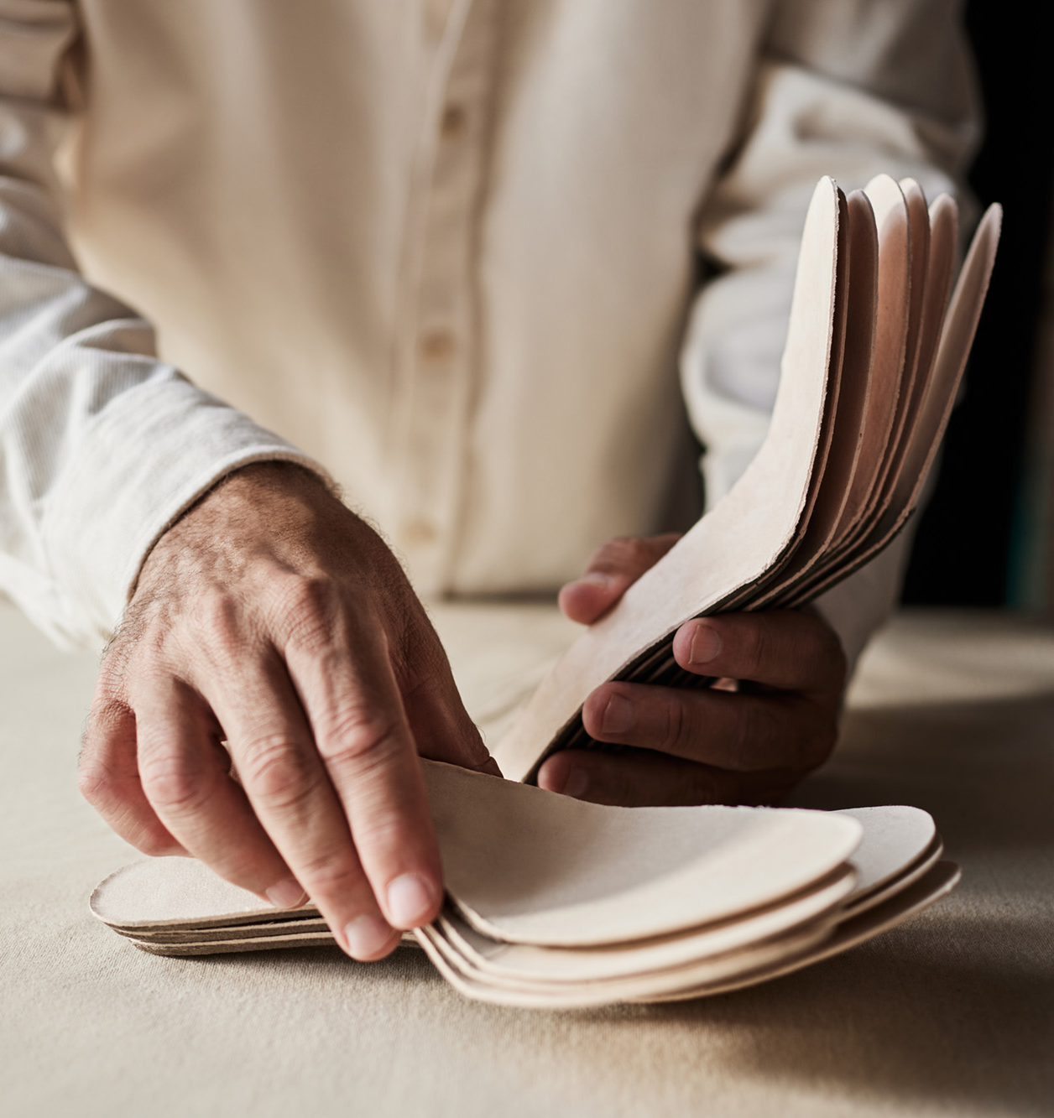
Naot’s uniquely engineered insoles are made with a flexible and shock absorbing footbed, providing comfort that has become our trademark.
“Next-level comfort”

Slide 19
Sales Channels

Slide 20

Canada
USA
Japan
Israel
Singapore
Australia
Stores in Israel
54 stores
Stores in the world
12 stores
(1 Soho NY, 5 Japan,
6 Canada)
Points of sale
in Israel
120
Sales points
in the world
3,000
Export scope
70%

Slide 21
Stores

Slide 22
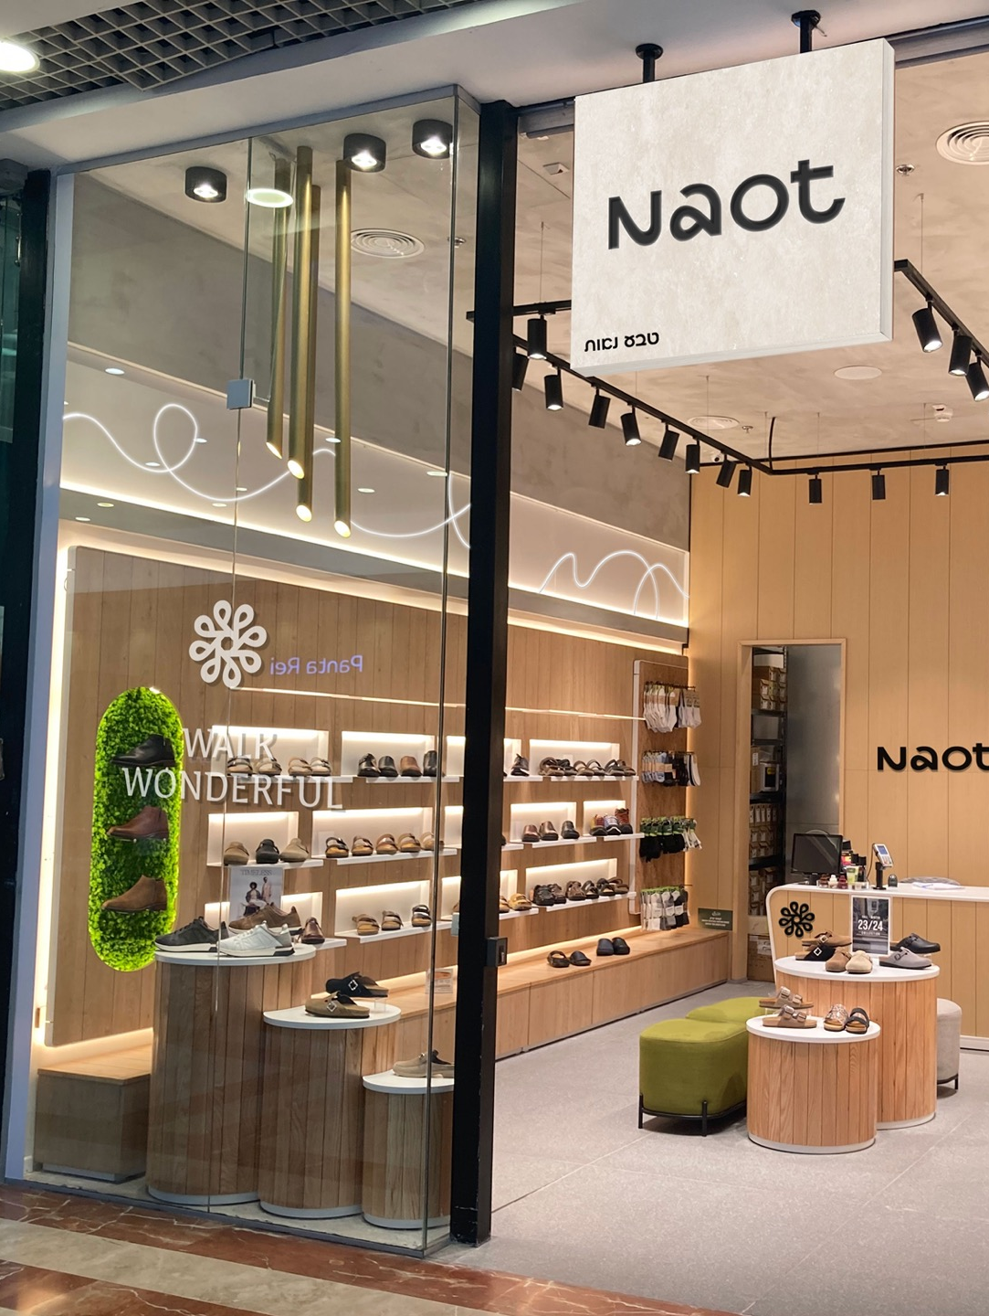
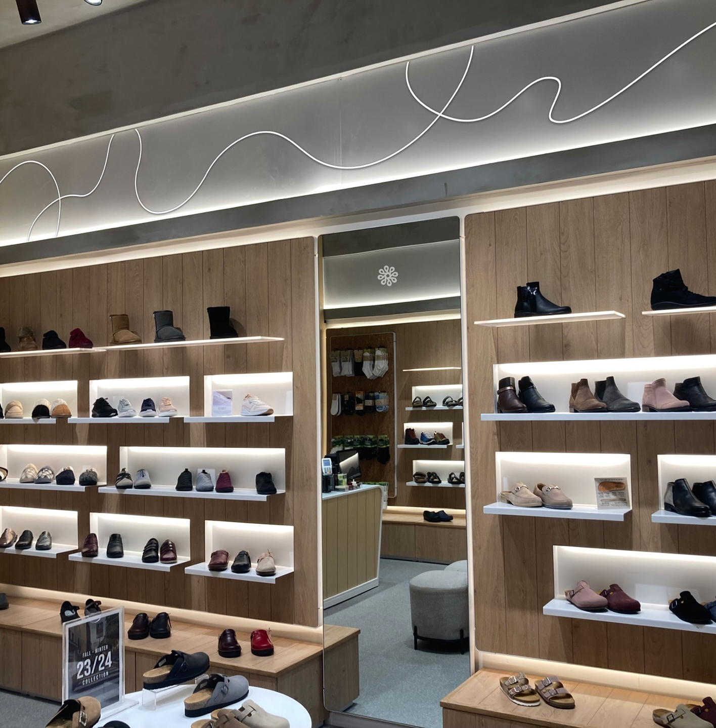

Slide 23

E-com & Social

Slide 24
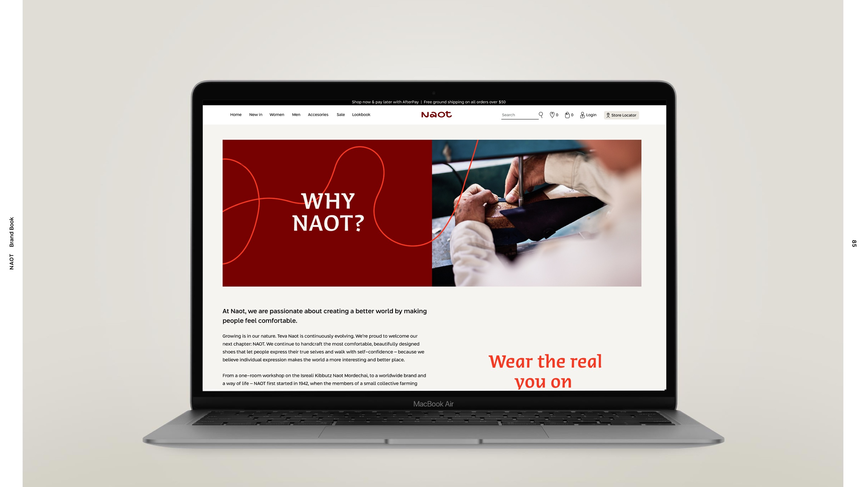
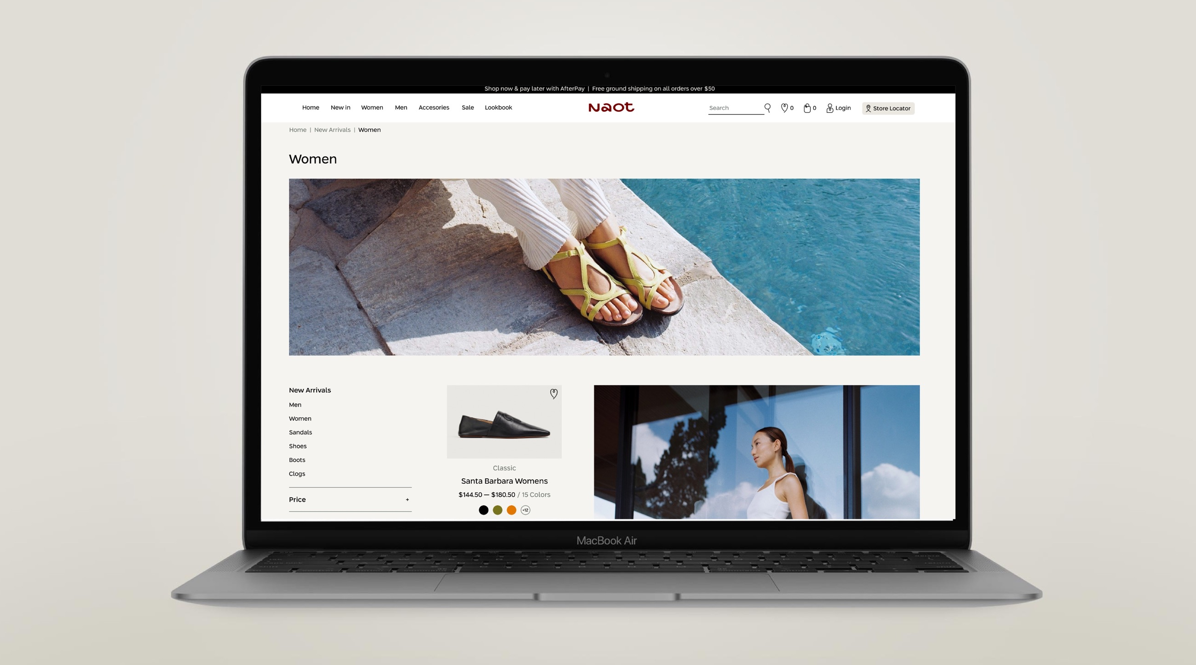
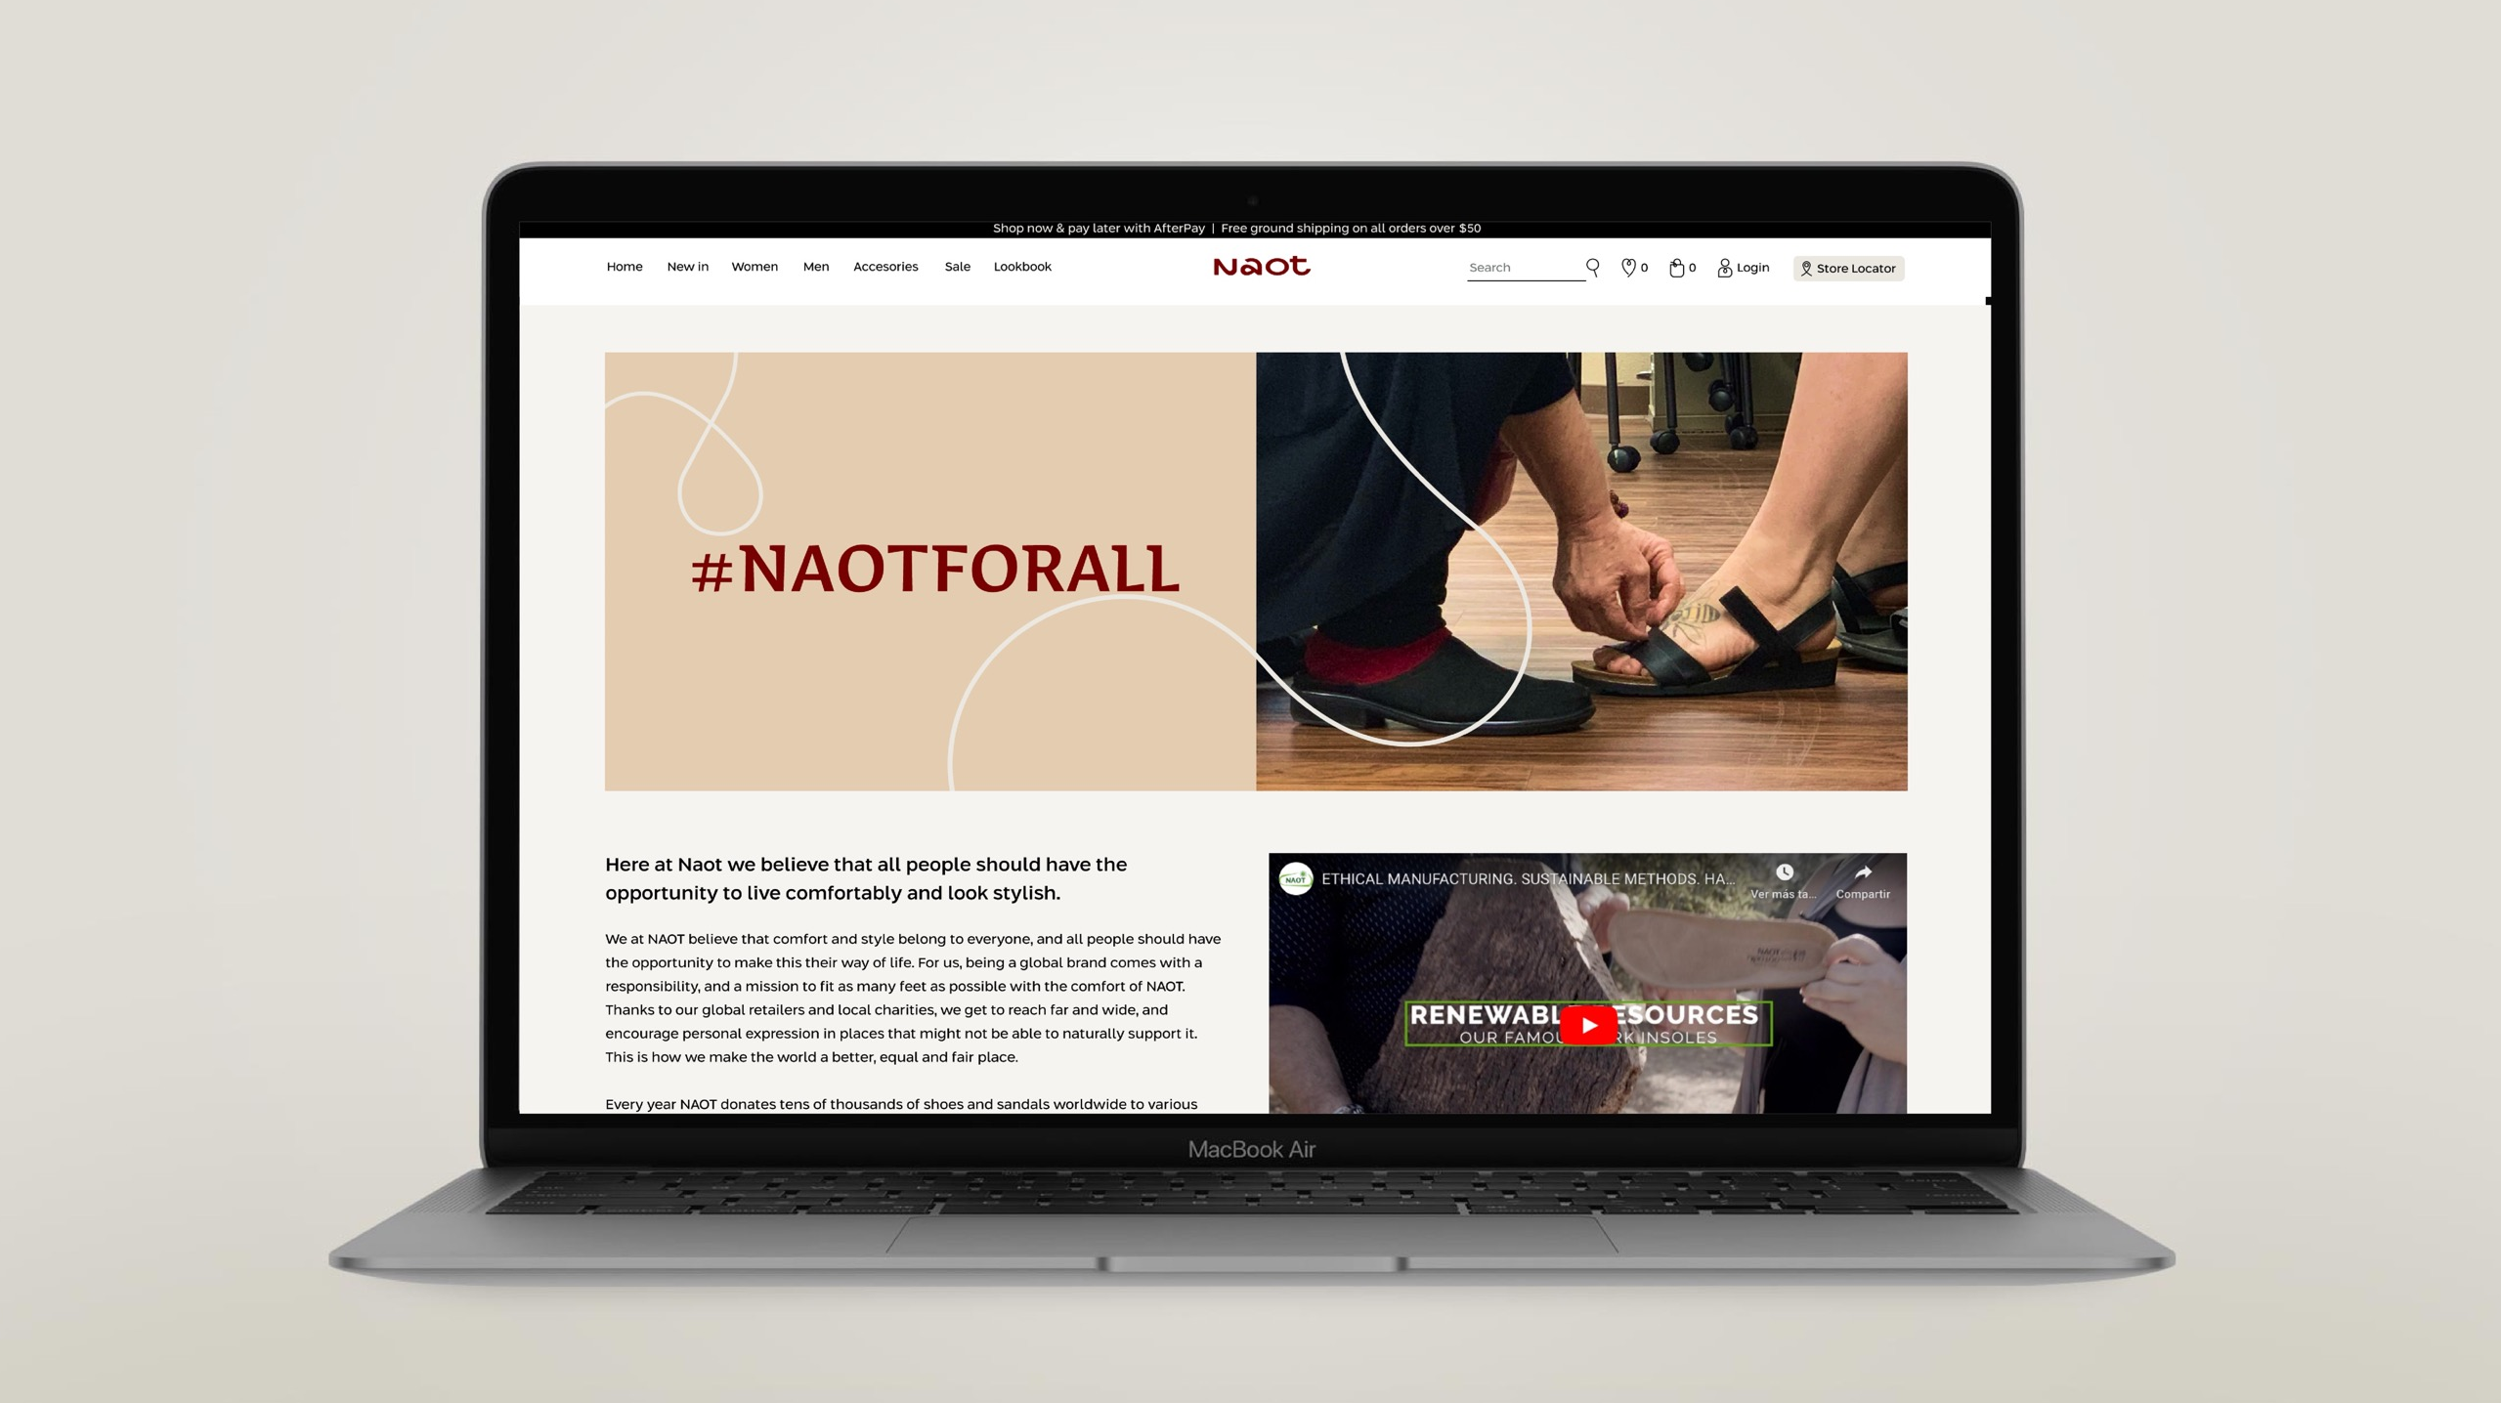

Slide 25
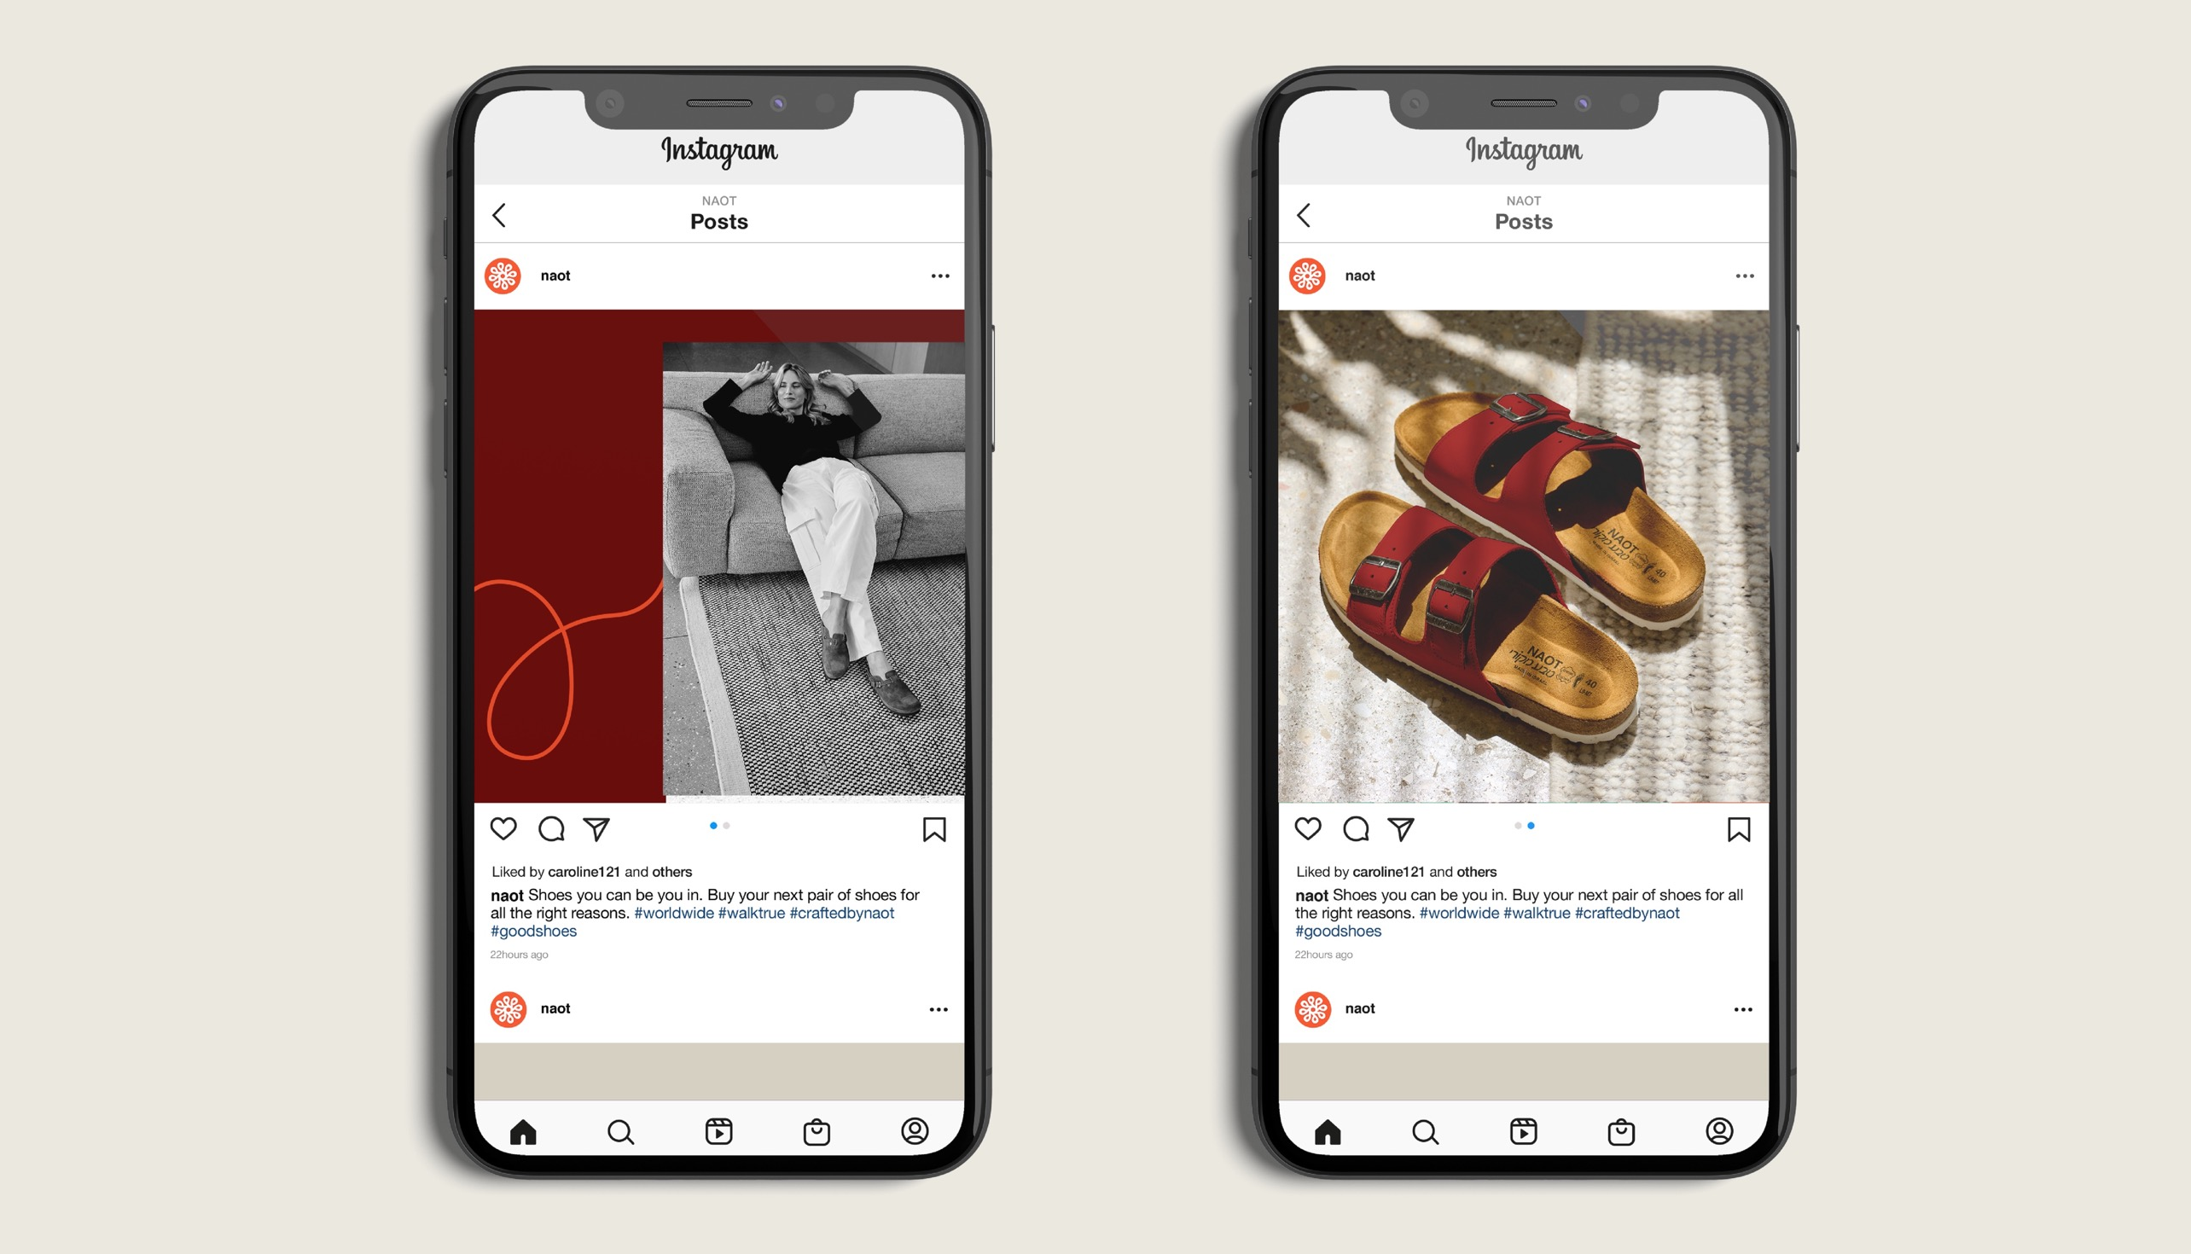

Slide 26
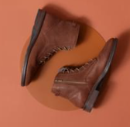
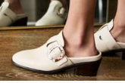
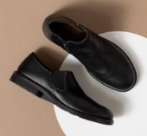
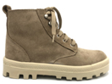
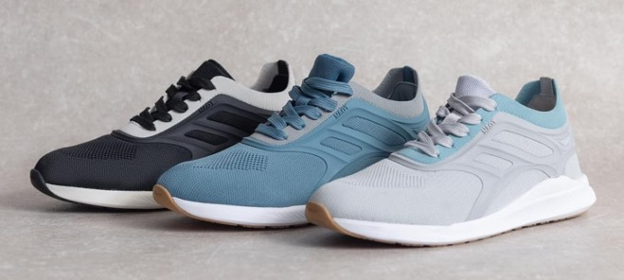
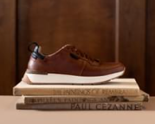
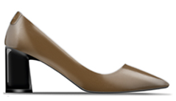
Comfort
Basic
portfolio
Women
Active
Men
Athleisure
Premium
Vegan

Slide 27
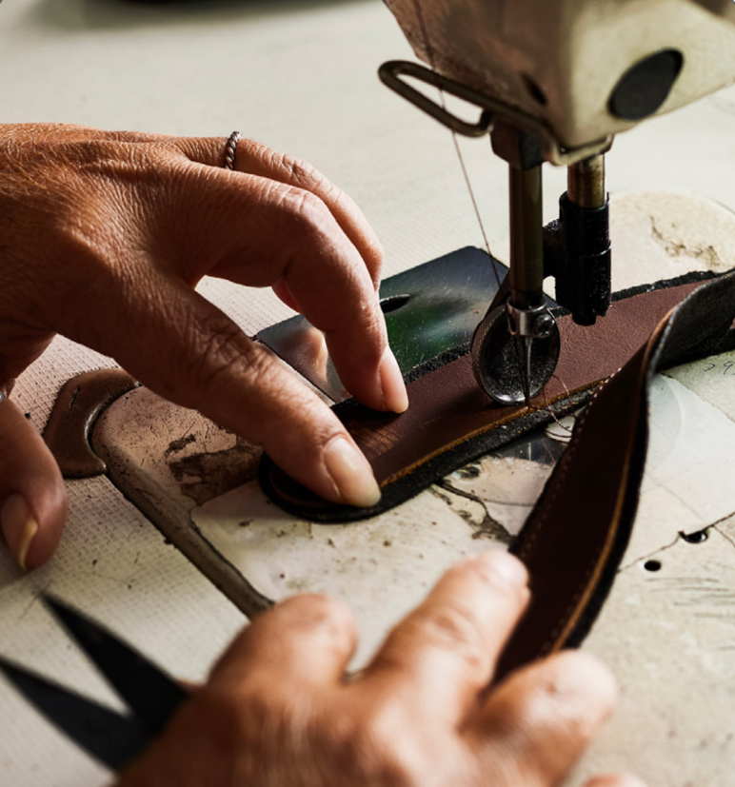
Over 250 different styles
2 new collections per year
700 colors
Diverse materiality

Slide 28
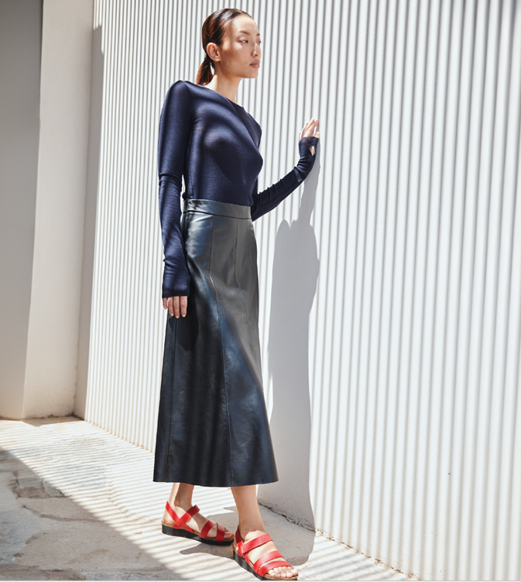
Casual

Slide 29
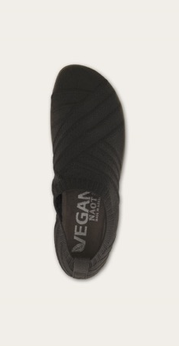
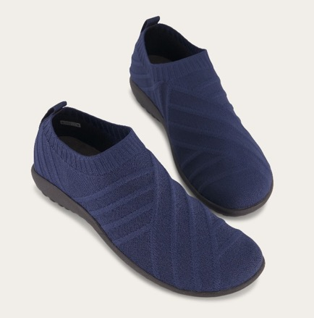
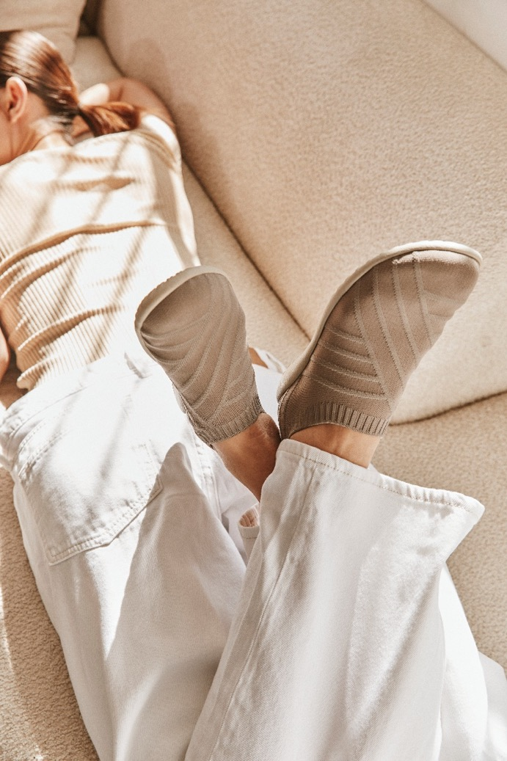
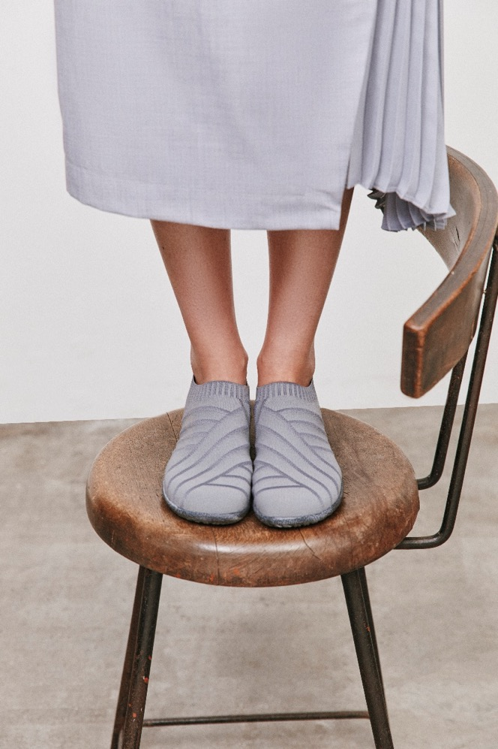
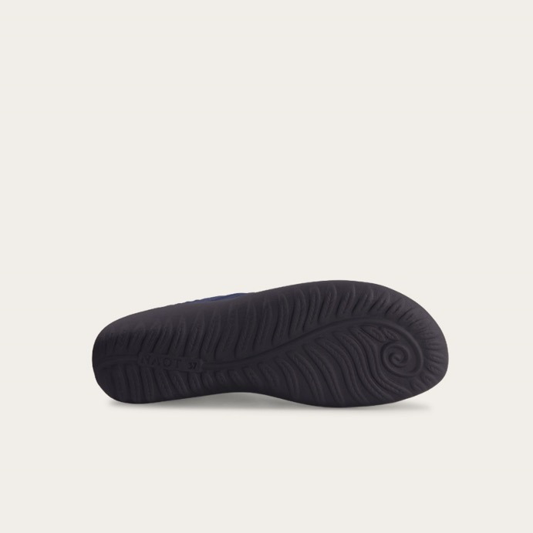
Active
KORU-OKAHU VEGAN

Slide 30
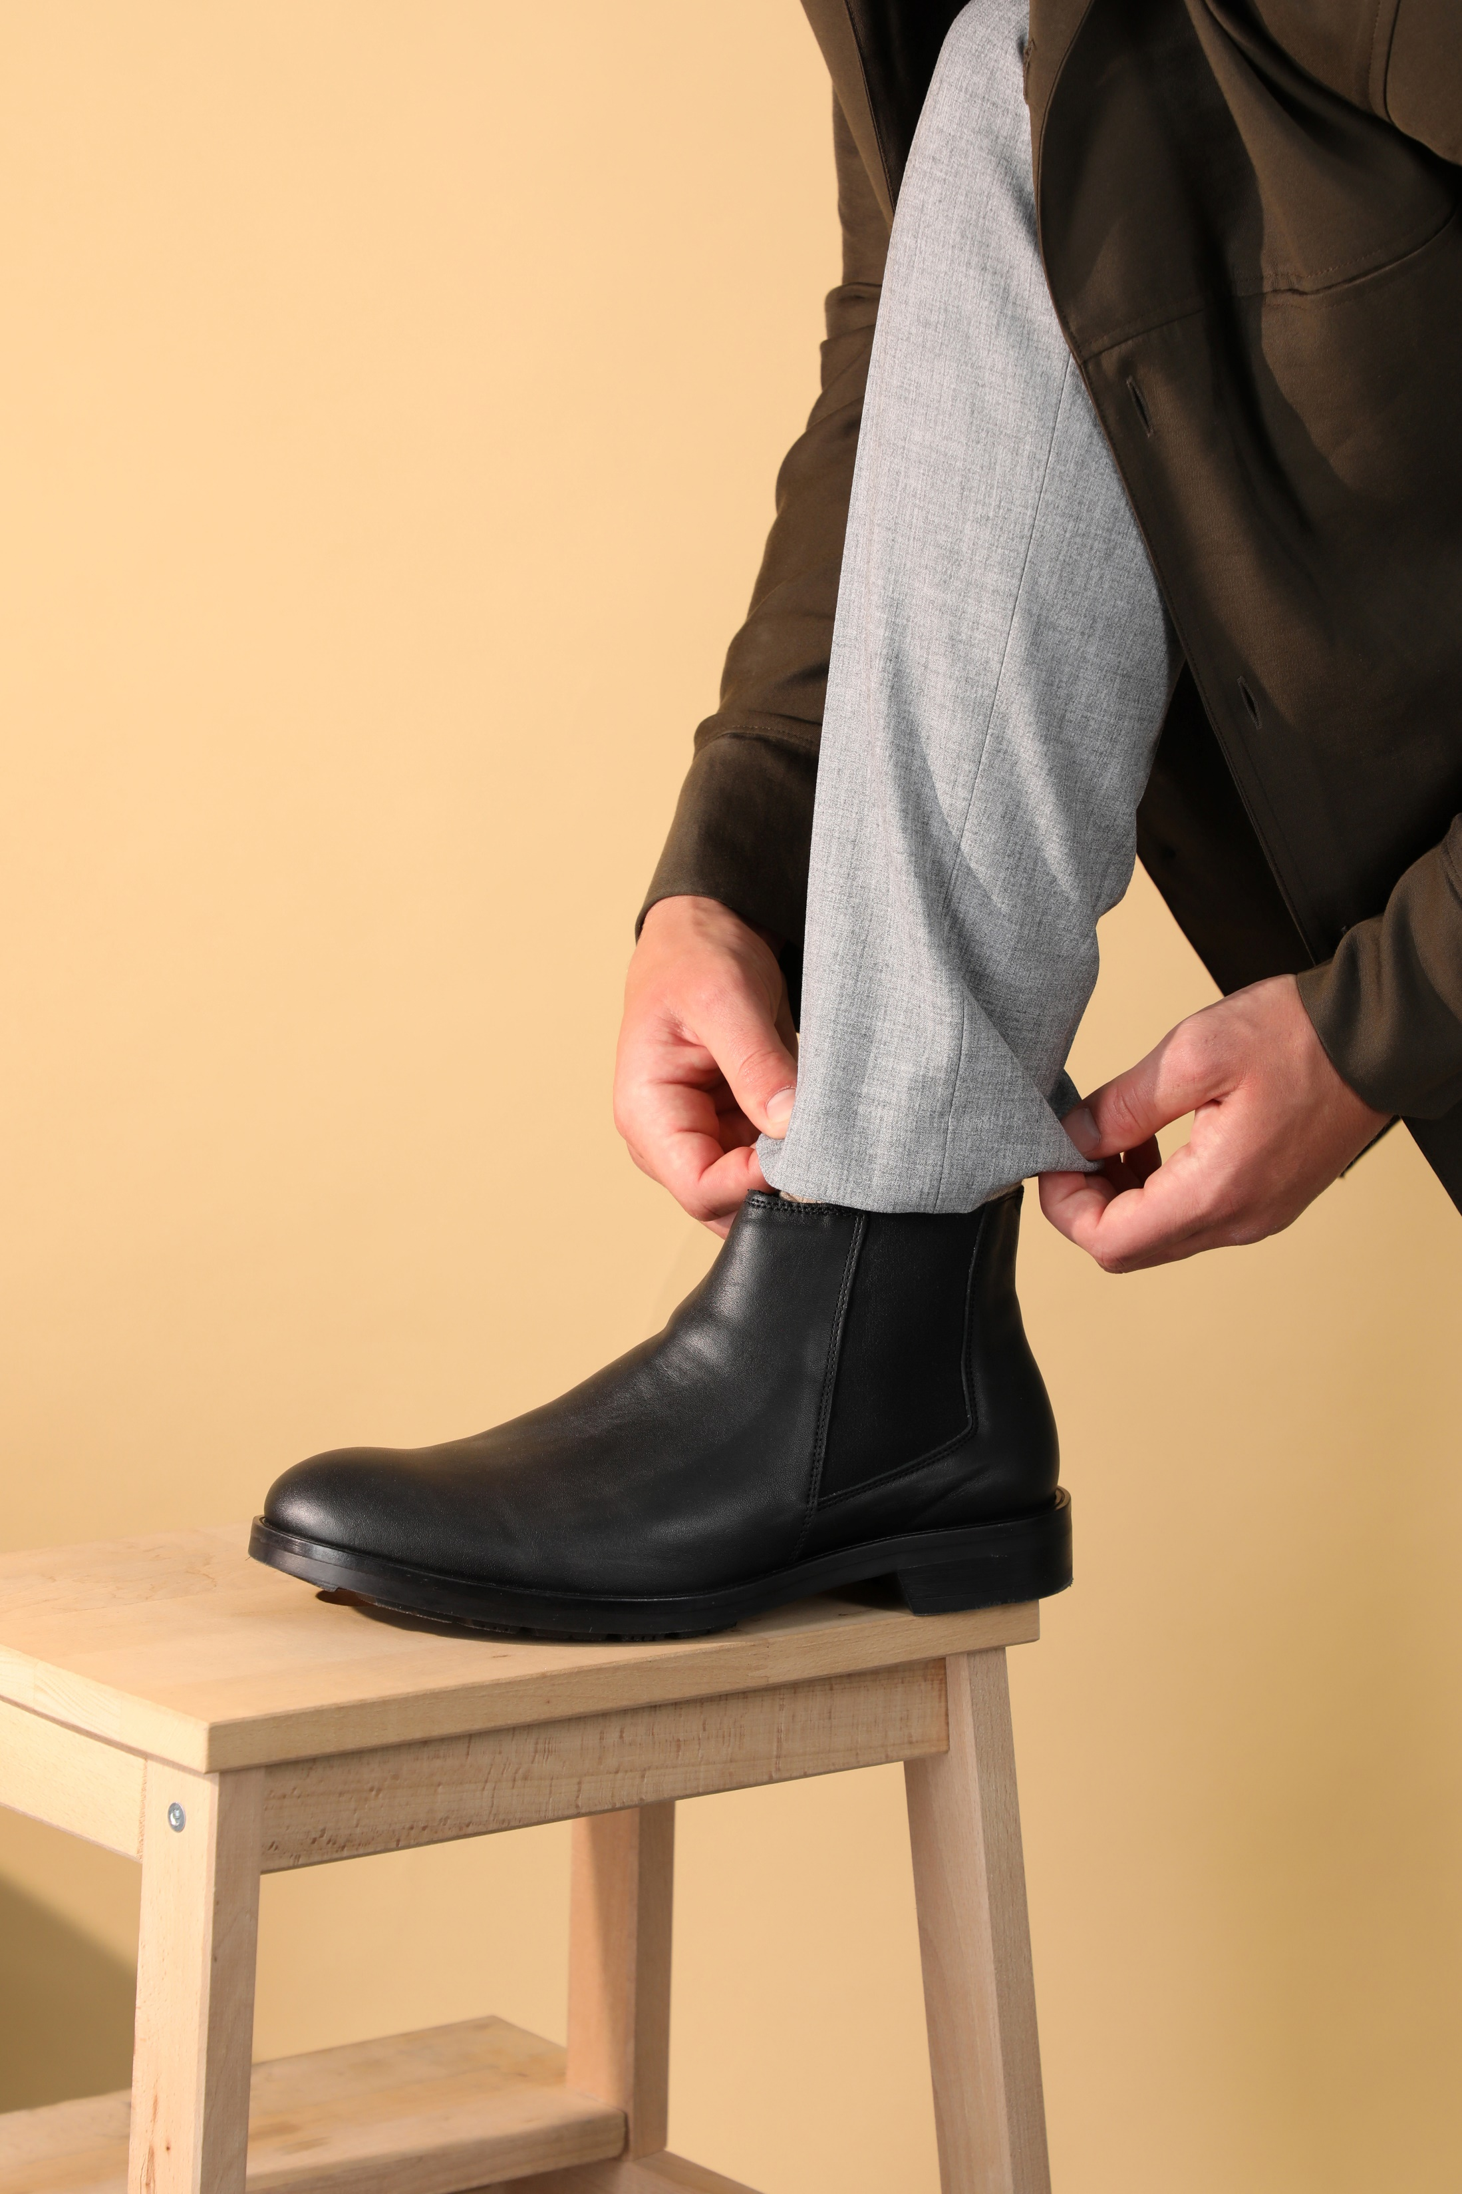
Men

Slide 31
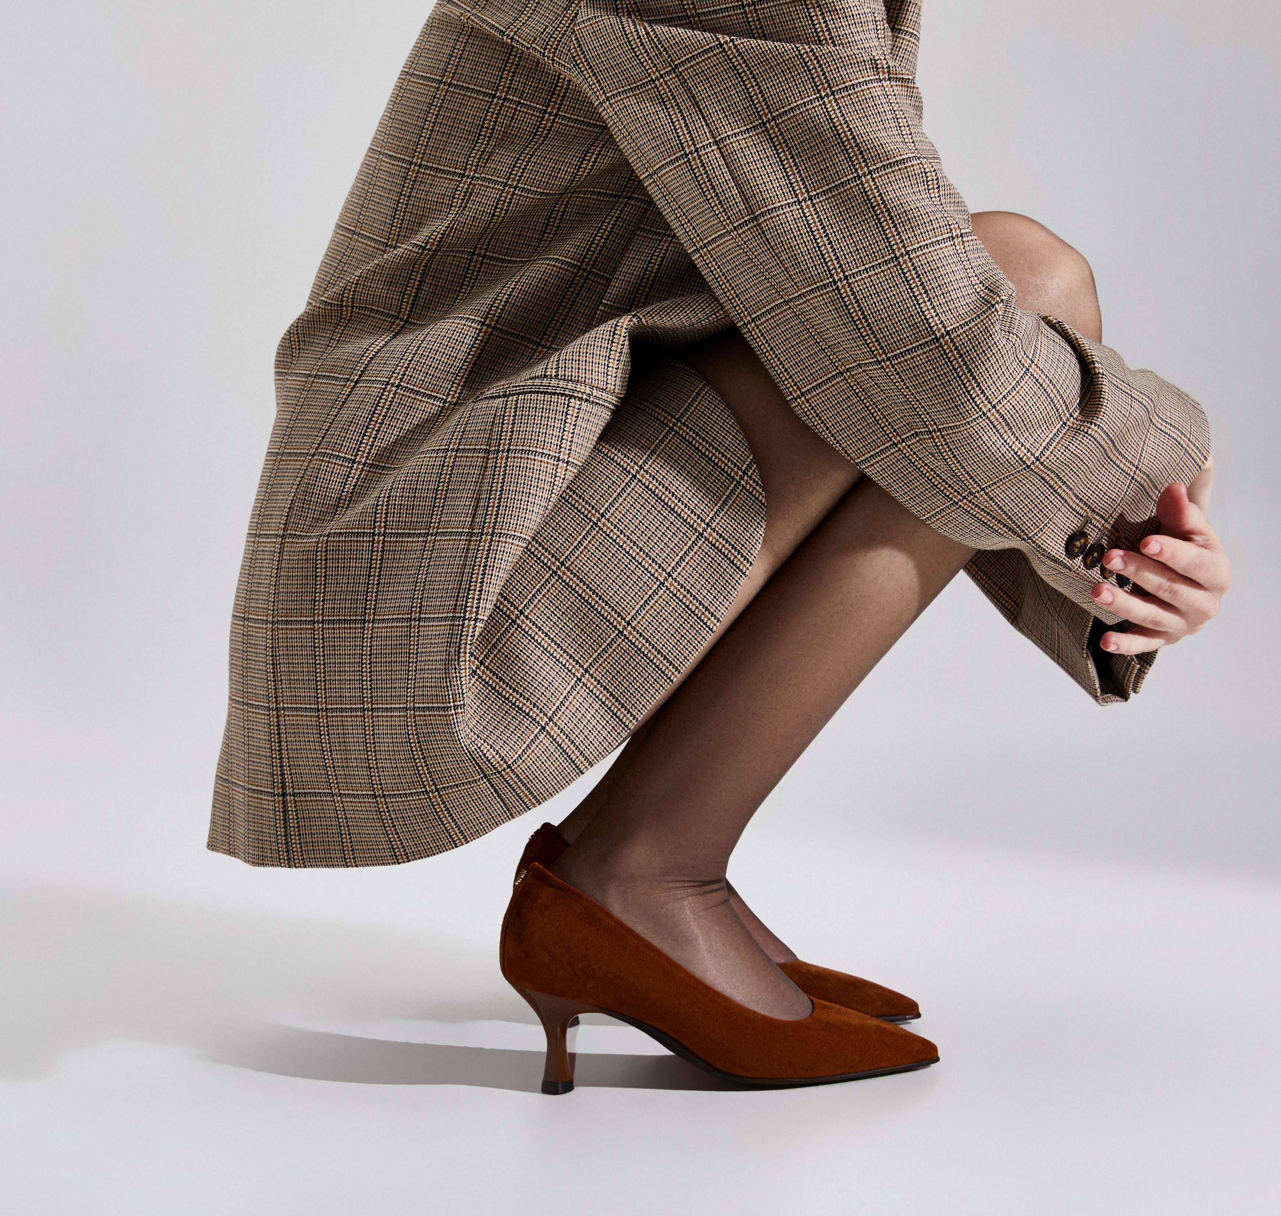
Premium

Slide 32
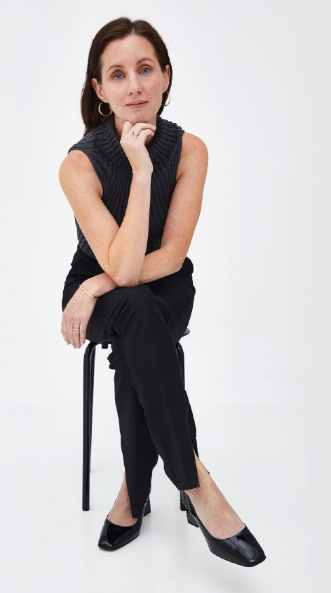


Premium: Ayelet by Naot
Ayelet by Naot is more than a shoe collection; it's a luxurious vision where comfort and style come together.
“As the President of Naot’s US operations, I have seamlessly integrated professional education into my life. This collection, born in collaboration with Italian designers, redefines comfort in luxury footwear using fine Italian leathers and natural materials”.

Slide 33
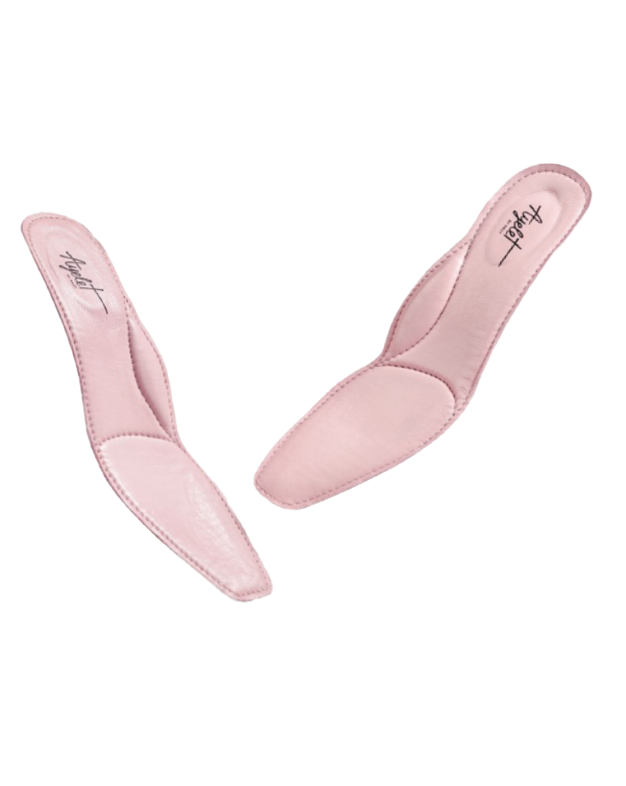

Seeking sophisticated style, demanding comfort
Special high tech material and Padding for enhanced heel Support and increased shock Absorption.
Ayelet is the perfect embodiment of both
Arch support made of high tech materials and padding.
Added padding and high Tech materials for extra Shock absorption at the Ball of your foot forIncreased all-day comfort.

Slide 34


Thank you!

